Slide 1
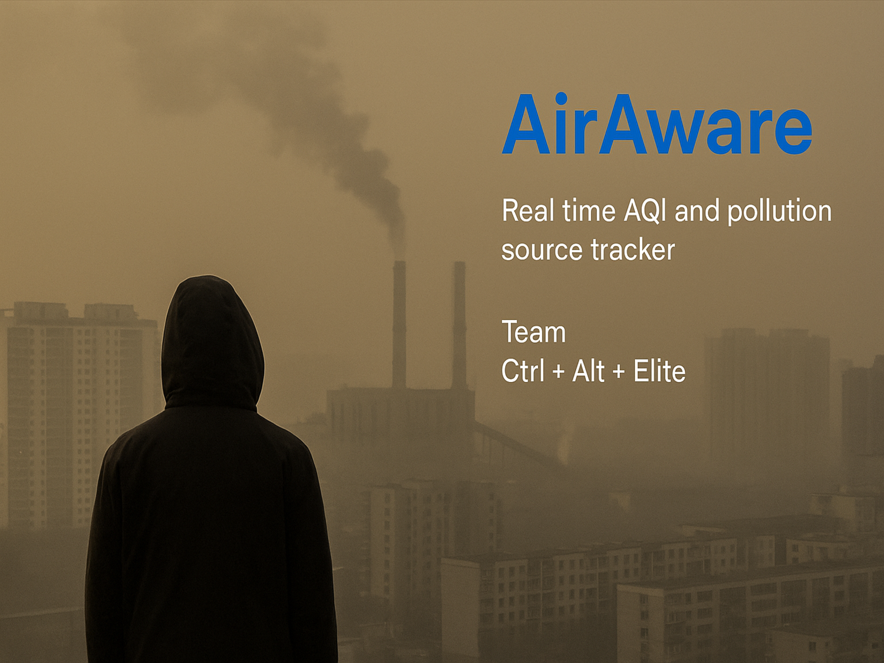

Slide 2







TABLE OF CONTENTS
Pollution
Existing AQI System – CPCB in India
Our Solution – Air Aware:
Future scope:
Techstack

Slide 3
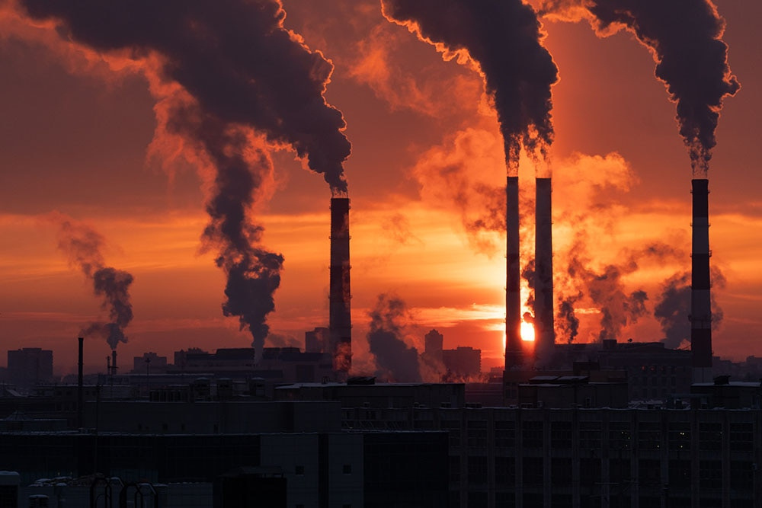
Pollution
Pollution, especially air pollution, poses a serious threat to human health and the environment. It leads to respiratory and cardiovascular problems, damages ecosystems, reduces visibility, and imposes a significant economic burden due to increased healthcare costs and decreased productivity. The major sources of air pollution include vehicular emissions, industrial discharges, construction dust, fossil fuel combustion, and agricultural activities like stubble burning. These sources release harmful pollutants such as particulate matter (PM2.5 and PM10), nitrogen dioxide (NO₂), sulfur dioxide (SO₂), and volatile organic compounds (VOCs) into the atmosphere. The root causes often lie in rapid urbanization, lack of real-time air quality monitoring, weak regulatory enforcement, and unplanned industrial growth, all of which contribute to deteriorating air quality.

Slide 4
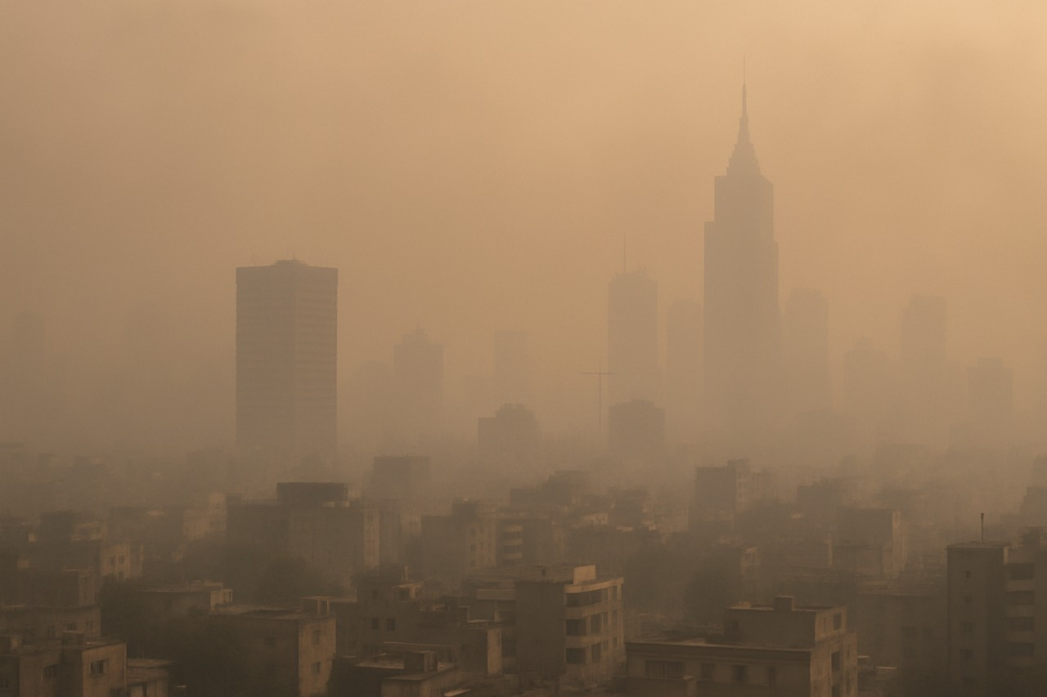
Existing AQI System – CPCB in India
In India, the Central Pollution Control Board (CPCB) monitors air quality through a nationwide Air Quality Index (AQI) system. The AQI is a composite measure that indicates the level of air pollution in a specific area using real-time data on key pollutants such as PM2.5, PM10, NO₂, SO₂, CO, O₃, and others. It categorizes air quality into six color-coded levels, ranging from “Good” to “Severe,” making it easy for the public to understand the immediate health risks. However, while the AQI effectively communicates the severity of pollution, it has a critical limitation — it does not identify the cause or specific source of pollution. Without this information, taking targeted action becomes difficult, leaving a gap in the system's effectiveness in controlling or mitigating pollution.

Slide 5


Our Solution – Air Aware:
Our solution, Air Aware, is a smart, data-driven software designed to go beyond conventional AQI systems. It first pulls live AQI data from open and trusted sources like CPCB. Next, it analyzes the data to identify the dominant pollutants contributing to poor air quality in a specific region. Using historical patterns and contextual environmental data, it then predicts the most likely cause of those pollutants—such as vehicular traffic, industrial activity, or crop burning. Finally, leveraging open-source geospatial mapping tools, the system pinpoints probable pollution sources on a map, helping authorities and citizens visualize the problem and take more informed, localized action.

Slide 6
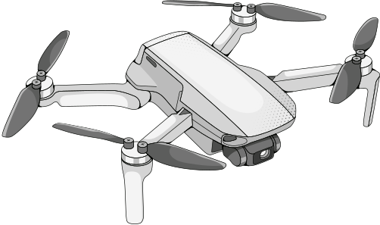
Future scope:
Integrate drone and satellite data for enhanced aerial monitoring.
Expand sensor coverage to rural and currently unmonitored areas.
Enable policy-level integration to support data-driven governance.
Improve prediction accuracy by including wind direction, temperature, and humidity.
Promote public participation through crowd-sourced pollution reports and alerts.

Slide 7

Techstack:
For the development of Air Aware, the backend will be built using Flask, a lightweight Python web framework ideal for API development and data handling. The frontend interface will be developed using React, offering a responsive and interactive user experience. Python will serve as the core programming language, especially for handling AQI data processing and prediction logic. MySQL will be used as the primary database to store live AQI readings, pollutant trends, and location-specific metadata. While machine learning integration is a future enhancement, the initial version focuses on rule-based cause prediction and geospatial analysis using external APIs and environmental datasets.

Slide 8
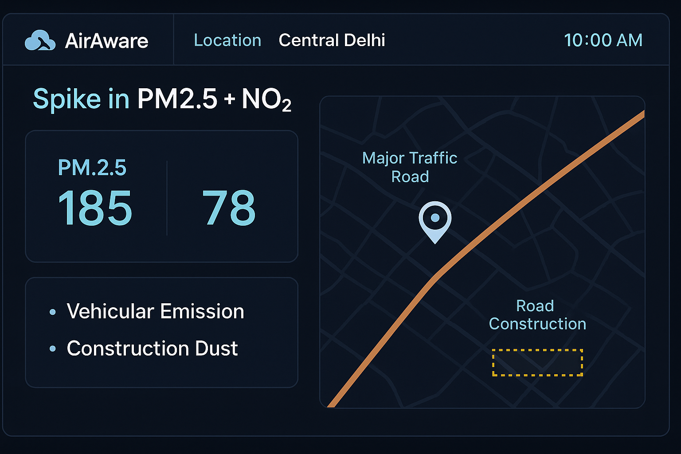

Slide 9



LET'S CREATE A CITY FREE OF
AIR POLLUTION TOGETHER!

